Slide 1
XML & XML Processing prerequisites Java Web Service
Rajeev Gupta MTech CS
rgupta.mtech@gmail.com

Slide 2
Session-1

Slide 3
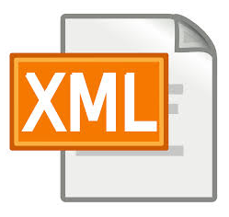
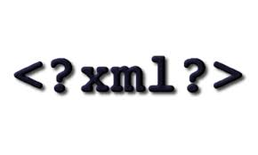
Agenda
Introduction to XML
Well formed XML
NameSpace
XML validation
DTD
Schema

Slide 4
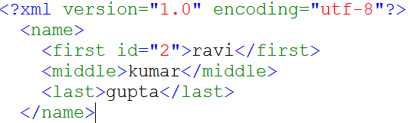
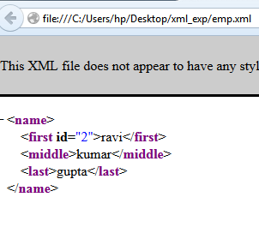
Introduction to XML
XML vs. HTML
Predefined Tags vs. extended
( user define ) markup language
binary data vs. text data
Idea of universal data format: SGML
there were a format that combined the universality of text files with the efficiency and rich information storage capabilities of binary files?
XML parsers
parsers read XML syntax and extract the information for us

Slide 5
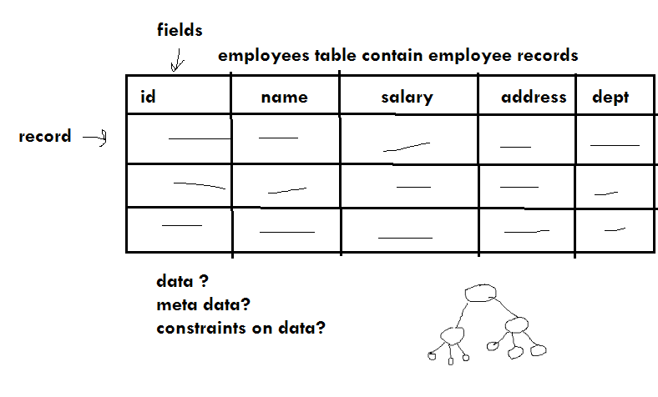

XML comparing with RDBMS
XML is very similar to database concept
XML can be used to store , retrieve and transmit data
XML databases
Most of the time XML is used for data interchange bw two system in inter-operatable way

Slide 6
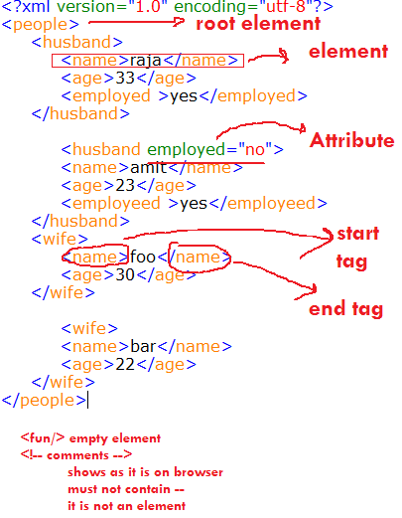
Nut and Bolt of XML

Slide 7
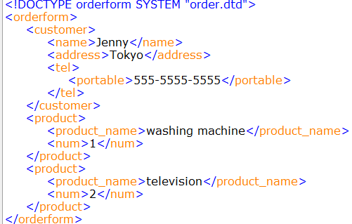
Well formed XML
Every start-tag must have a matching end-tag, or be a self-closing tag.
Tags can’t overlap; elements must be properly nested.
XML documents can have only one root element
Element names must obey XML naming conventions
XML is case sensitive
XML will keep whitespace in your PCDATA ie In XML, the whitespace stays
Example : Order.xml

Slide 8
Entity Reference
Well formed XML can not have symbol like > < &, we need to use Entity in place of them
<comparison>6 is &lt; 7 &amp; 7 &gt; 6 </comparison>
&amp;—the & character
&lt; —the < character
&gt;—the > character
&apos;—the ‘ character
&quot;—the “ character

Slide 9
CDATA character data
If you have a lot of < and & characters that need escaping, you may find that your document become ugly
Using CDATA sections, you can tell the XML parser not to parse the text, but to let it all go by until it gets to the end of the section.
CDATA sections look like this:
<comparison><![CDATA[6 is < 7 & 7 > 6]]></comparison>
<script language=’JavaScript’><![CDATA[
function myFunc()
{
if(0 < 1 && 1 < 2)
alert(“Hello”);
}
]]></script>

Slide 10
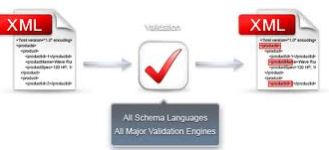
DTD valid xml
Need of Schema?
Two parties must agree on some agreement
Aka contract bw two software systems
What schema tell us?
What data is allowed?
What data is required?
How data is organized?
An Valid XML document must be valid but reverse may not be true

Slide 11
DTD (Document Type Definition)
A way to validate xml document.
What DTD can tell us
What element can appear/must appear?
what should be order of element?
Information about data that contain?
attribute information required?
What DTD do not tell?
DTD do not support namespace concept
data type
Semantic meaning of an element(whether data is name or date?)

Slide 12
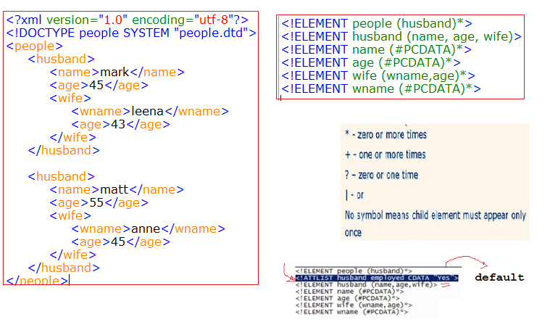
Understanding DTD
Attribtues in XML
<!ATTLIST contact person ID #REQUIRED>
In the document you could add the unique ID: <contact person=”Jeff_Rafter”>

Slide 13
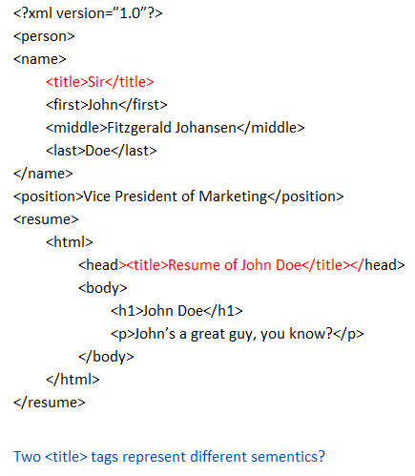
XML Namespaces
A namespace is a purely abstract entity, aka java package
It’s nothing more than a group of names that belong with each other conceptually
Two <title> tags represent different semantics?

Slide 14
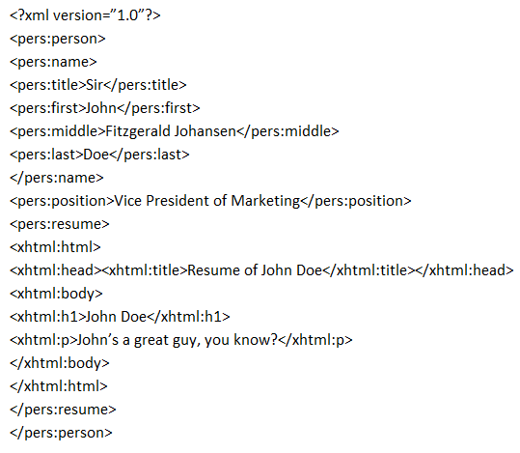
Approach 1 Using prefix
Problem with approach 1
Who will monitor the prefixes?
The whole reason for using them is to distinguish names from different document types, but if it is going to work, then the prefixes themselves also have to be unique

Slide 15
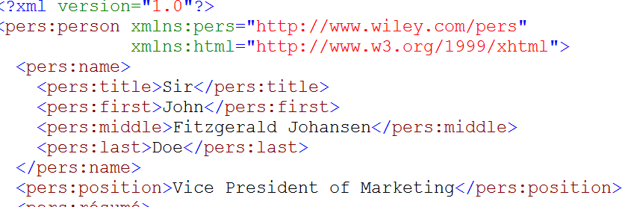
Approach 2 using URI
A URI (Uniform Resource Identifier) is a string of characters that identifies a resource, URI may be an valid URL
<?xml version=”1.0”?>
<{http://www.wiley.com/pers}person>
<{http://www.wiley.com/pers}name>
<{http://www.wiley.com/pers}title>
How actually namespace specified?

Slide 16
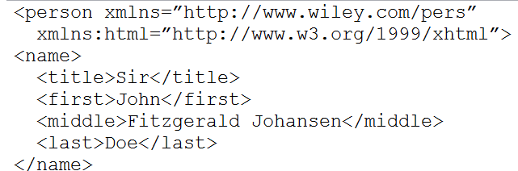
Default namespace
We can use default namespace to simplify last approach
We can make one of the namespace as default Here xmlns=”http://www.wiley.com/pers” is default namespace
An xml doc can not have 2 default namespace in an XML doc

Slide 17
xml Schema
Why XML Schema?
XML Schemas are created using basic XML, while DTDs utilize a separate syntax.
XML Schemas fully support the Namespace Recommendation.
XML Schemas enable you to validate text element content based on built-in and user-defined data types
XML Schemas enable you to more easily create complex and reusable content models
XML Schemas enable the modelling of programming concepts such as object inheritance and type substitution

Slide 18
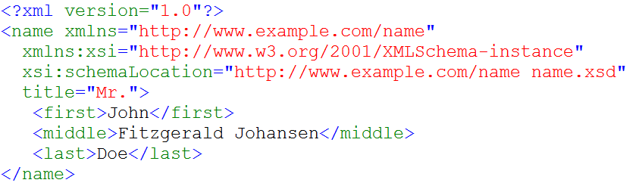
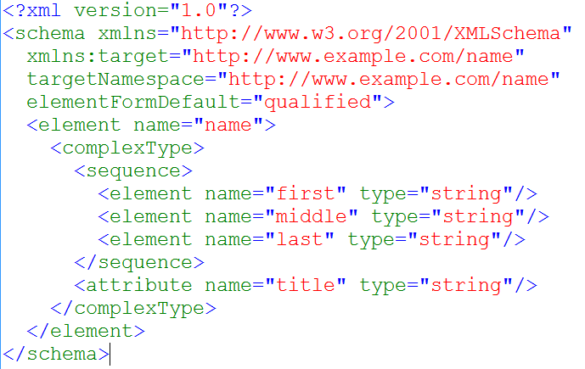
Example: name.xsd

Slide 19
Session-2

Slide 20
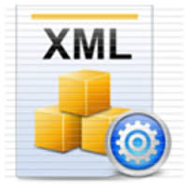
Agenda
Introduction to XML data processing
XML processing techniques
DOM
SAX
JAXB
JSON

Slide 21
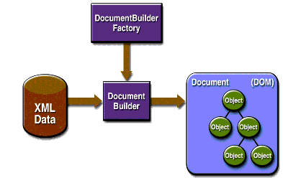
DOM XML Parser
The DOM is the easiest to use Java XML Parser.
It parses an entire XML document and load it into memory, modelling it with Object for easy model traversal.
DOM Parser is slow and consume a lot memory if it load a XML document which contains a lot of data.

Slide 22
XML DOM processing
Reading XML file in Java using DOM
DOM parser to modify an existing XML file
Add a new element
Update existing element attribute
Update existing element value
Delete existing element
http://www.mkyong.com/java/how-to-read-xml-file-in-java-dom-parser/

Slide 23
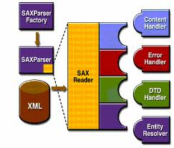
SAX XML Parser
SAX parser use callback functions (org.xml.sax.helpers.DefaultHandler) to informs clients about the XML document structure
It is faster then DOM
Do not require complete xml document in advance

Slide 24
Reading XML file in using SAX
Following are SAX callback methods :
startDocument() and endDocument()
Method called at the start and end of an XML document
startElement() and endElement()
Method called at the start and end of a document element
characters()
Method called with the text contents in between the start and end tags of an XML document element

Slide 25
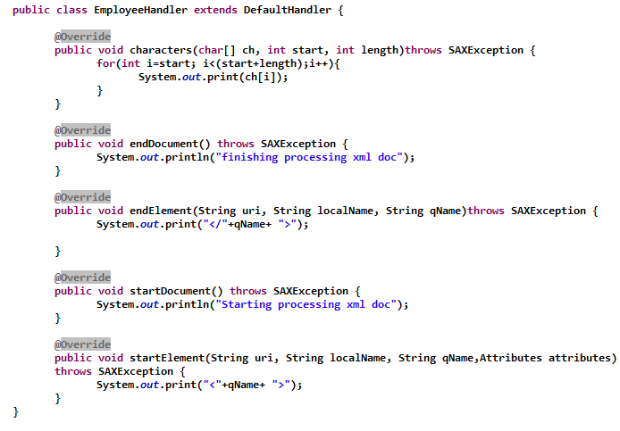
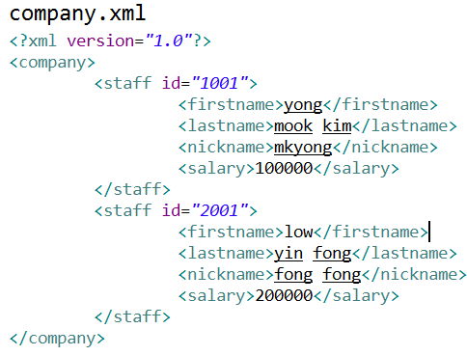

Hello World SAX

Slide 26
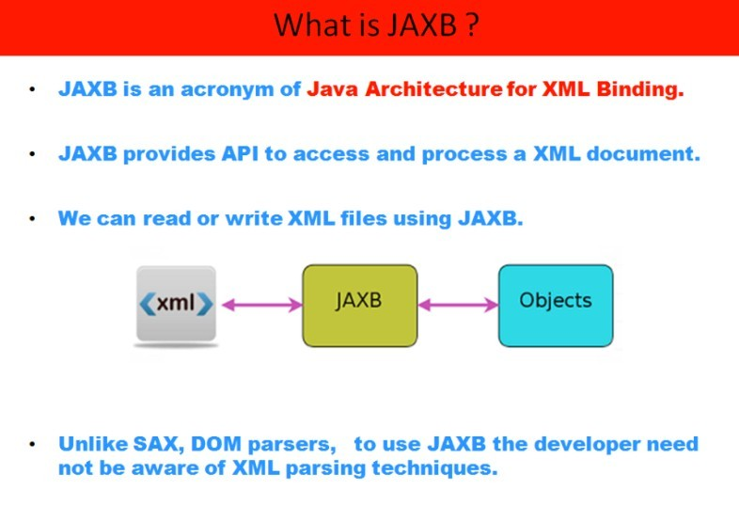

Slide 27
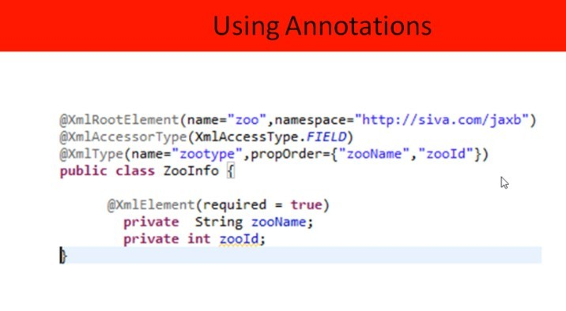

Slide 28
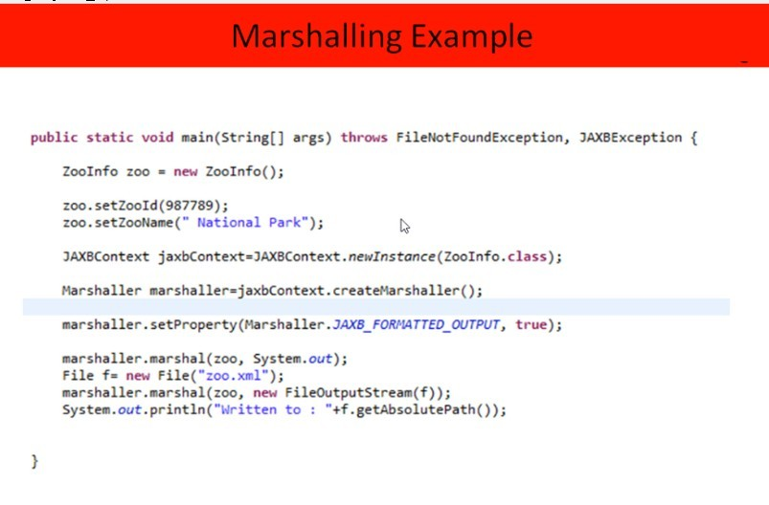

Slide 29
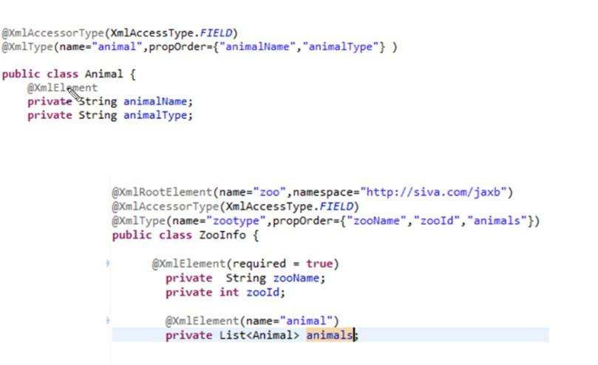

Slide 30
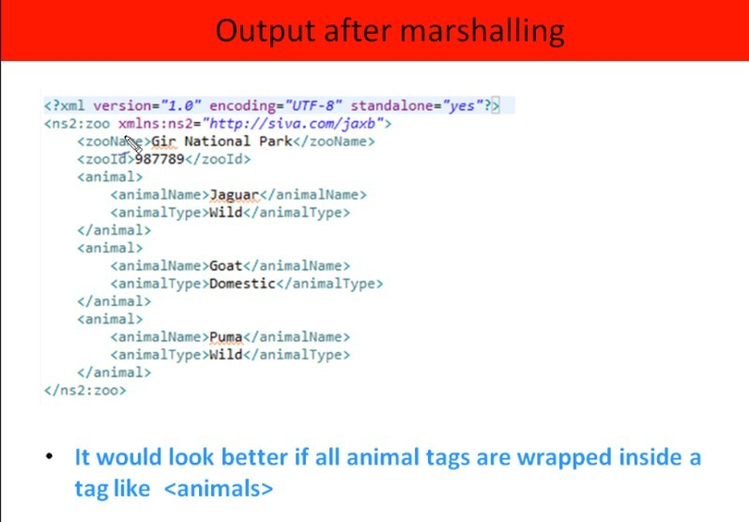

Slide 31
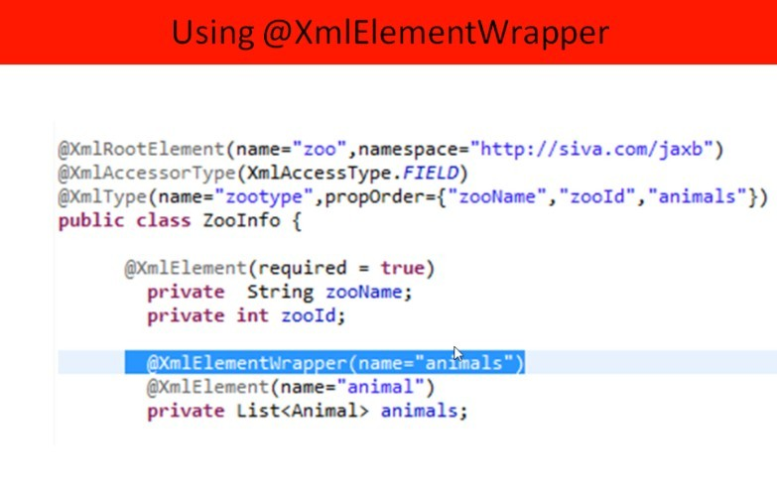

Slide 32
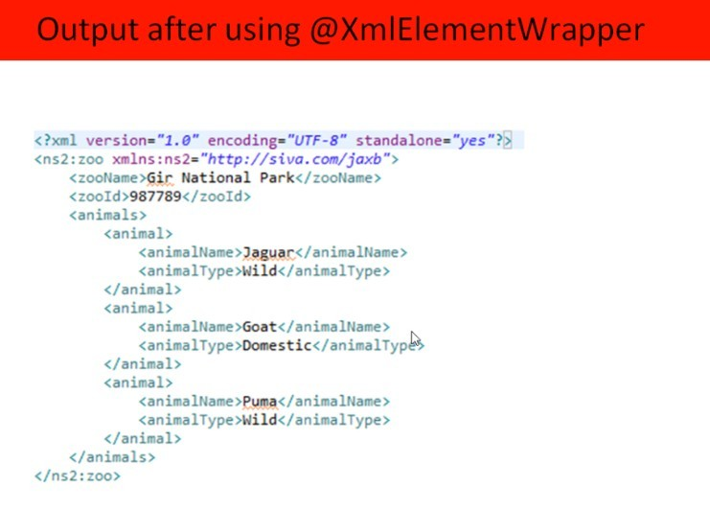

Slide 33
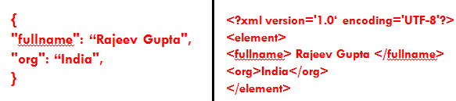
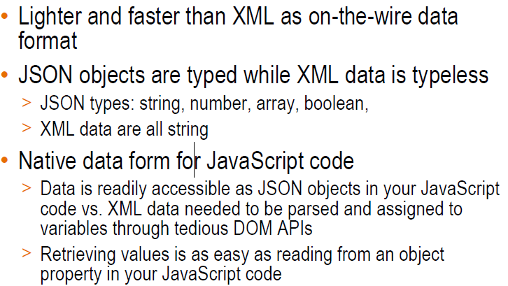
Why JSON is used in AJAX (optional topic)
JSON is widely used in AJAX, WS ?

Slide 34
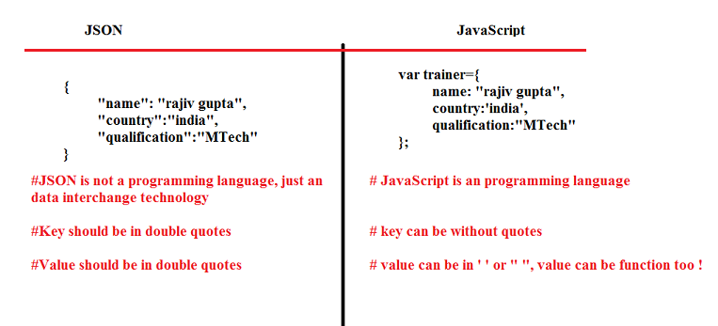
JSON vs. JavaScript

Slide 35
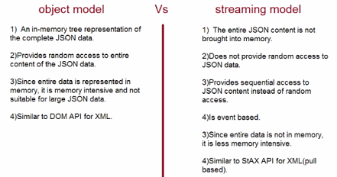
JSON processing
JSON API provides two ways for JSON processing:
Object Model API
It’s similar to DOM Parser and good for small objects.
Streaming API
It’s similar to StaX Parser and good for large objects where you don’t want to keep whole object in memory.

Slide 36
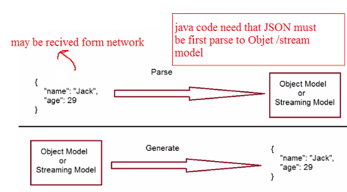
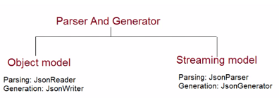
JSON API (Important Interface)
javax.json.JsonReader: We can use this to read JSON object or an array to JsonObject. We can get JsonReader from Json class or JsonReaderFactory.
javax.json.JsonWriter: We can use this to write JSON object to output stream.
javax.json.stream.JsonParser: This works as a pull parser and provide streaming support for reading JSON objects.
javax.json.stream.JsonGenerator: We can use this to write JSON object to output source in streaming way.
javax.json.Json: This is the factory class for creating JSON processing objects. This class provides the most commonly used methods for creating these objects and their corresponding factories. The factory classes provide all the various ways to create these objects.
javax.json.JsonObject: JsonObject represents an immutable JSON object value

Slide 37
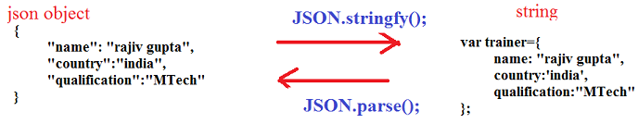
JSON to JavaScript notation interchange

